Slide 1

HOSTEL MANAGEMENT APP & 2048 GAME SYSTEM
24 October 2016
Under the guidance of Dr. Sanjeev Sofat
Amisha Jindal (14103061)
Divya Sharma (14103062)
Taresh Dewan (14103053)

Slide 2
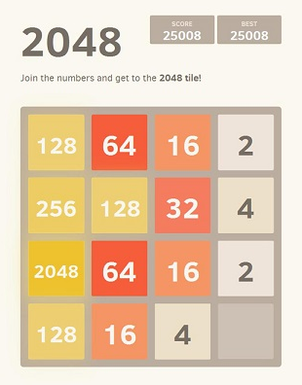
GAME 2048
Objectives
Design
Future Scope
UML Diagrams

Slide 3

OBJECTIVES
Our objectives include :
First step into the domain of game making.
To exercise the logical side of the brain.

Slide 4
DESIGN
Front - End : Java (Netbeans)
Our project will involve the following things :
4x4 grid (16 squares) with numbers in powers of 2.
A square block can be moved in 4 directions : UP, DOWN, RIGHT, LEFT with a possibility of an empty block being generated.
If an empty block is generated, the machine automatically fills it with a value of 2 or 4 with probabilities being 0.9 and 0.1 respectively.
A move is made when two adjacent cells have same value and they merge to give a sum of those values.
Scores are given to a user on the basis of Heuristics.

Slide 5
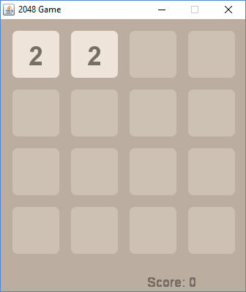
GAME START

Slide 6
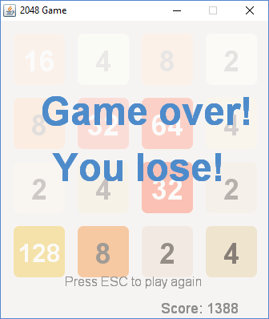
GAME END

Slide 7
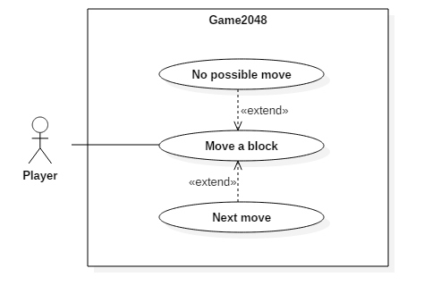
USE-CASE DIAGRAM

Slide 8
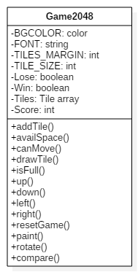
CLASS DIAGRAM

Slide 9
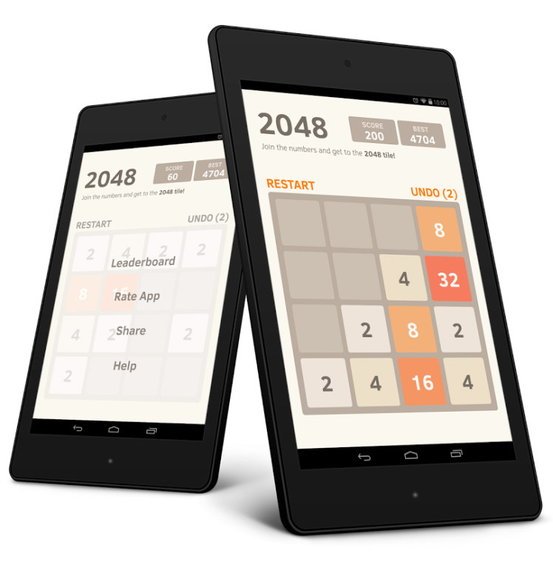
FUTURE SCOPE
The future scope of this game includes :
This game can be converted to an Android and Web application.
It can be customized as per the user’s need.

Slide 10
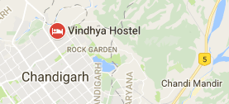
HOSTEL MANAGEMENT APP
Objectives
Design
Future Scope
UML Diagrams

Slide 11

OBJECTIVES
Our objectives include :
Reducing manual work and tedious paperwork.
Reducing inconsistency, ambiguity, data access and retrieval problems.
Ensuring effective communication between management and students.

Slide 12
DESIGN
Back - End : SQLite
Front - End : Java (Android Studio)
Our project will be based on the management system of Vindhya Hostel, PEC University of Technology. It will automate the daily activities of the hostel so as to reduce manual work. It shall include the following aspects :
Student Details
Mess Bills
Complaints
Staff Details
Night mess
Hostel occasions management
Entry/Exit/Long leave/Late leave management
Management of workers

Slide 13
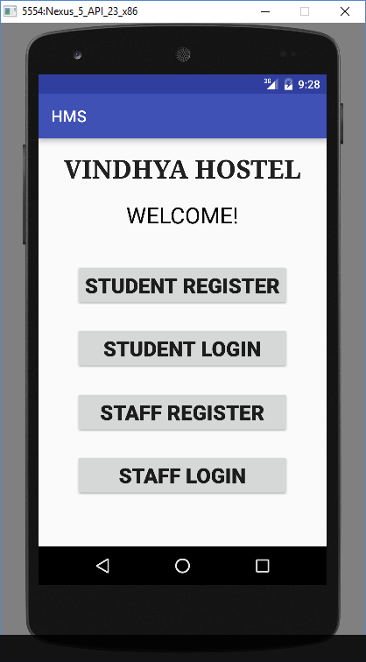
SCREENSHOTS – MAIN PAGE
The main page of our application will appear as shown on the side.

Slide 14
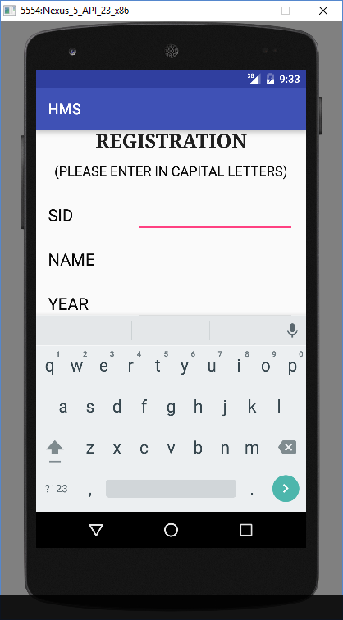
STUDENT REGISTRATION PAGE
A student can register into the application through the page shown.

Slide 15
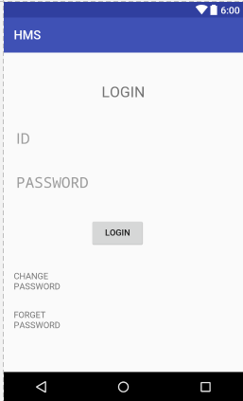
STUDENT LOGIN PAGE
A student can login into the application through the portal.

Slide 16
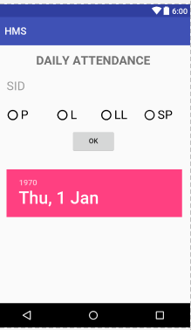
DAILY ATTENDANCE PAGE
The daily attendance would be taken through the following page.

Slide 17
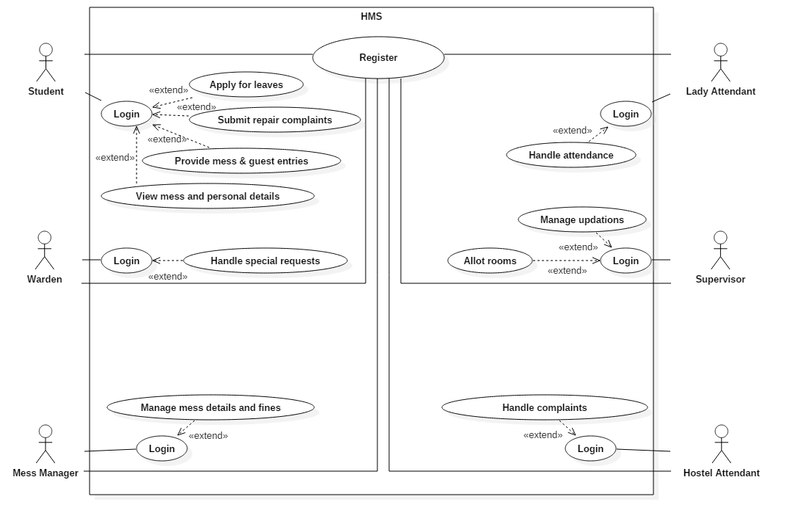
USE-CASE DIAGRAM

Slide 18
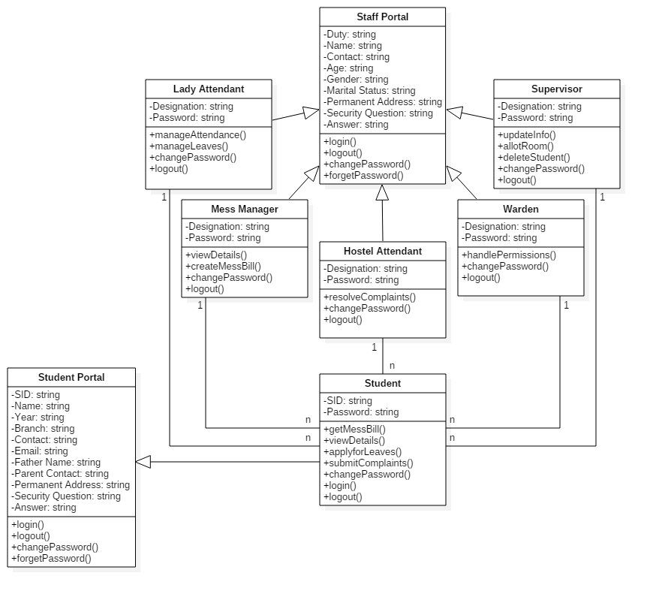
CLASS DIAGRAM

Slide 19

FUTURE SCOPE
The future scope of this application includes :
Actual implementation in Vindhya Hostel, PEC.
Customization by adding or removing any features.

Slide 20


